Slide 1
Superstore Analysis
IBM – Edunet

Slide 2


Table of Contents
INTRODUCTION
Problem Topic
Agenda
Project overview
End Users
Solution
Findings, Recommendations and conclusion
Modelling
Results
Links

Slide 3


INTRO
Name : Satyam Raj
SkillsBuild Email ID : satyamraj1903@gmail.com
College Name : Sershah Engineering College
College State : Bihar
Internship Domain : Data Analytics
Internship Start Date : 12-06-2023
Internship End Date : 24-07-2023

Slide 4
Problem Topic
Case Study : Analysis of Superstore

Slide 5
Agenda
Performance evaluation : Analyzing a superstore's performance involves assessing various metrics such as sales revenue, profit margins, customer satisfaction, and market share. This analysis helps identify areas of strength and weakness, enabling the management to make data-driven decisions for improvement.
Customer behavior understanding : Analyzing customer behavior within a superstore can provide insights into purchasing patterns, preferences, and trends. This information helps in optimizing product placement, pricing strategies, and inventory management to enhance customer satisfaction and increase sales.

Slide 6
Project Overview
This project, I analyzed the areas where there are least sales of a Superstore In this project. I used libraries like panda, matplotlib, NumPy and seaborn to explore which region has least sales, how are the sales of each category is divided across the regions, how are the Sales across each segment, which State has the lowest sales and which city has the lowest sales.
The given dataset was given as a task from the Edunet Foundation. With this dataset, I tried to visualize the sales of category, sub-category in each states and country to achieve the objective of as of which are the areas where business is low. The name of the Dataset used for this projects is SampleSuperstore.csv. There are 9994 rows and 13 columns with each row containing data about commodities.

Slide 7
Who are the
END users
Management and Executives : Senior management and executives within the superstore rely on data analysis to gain strategic insights and make informed decisions.
Marketing and Sales Teams : Marketing and sales teams utilize data analysis to understand customer behavior, segment the market, and identify trends and pattern
Operations and Supply Chain Teams : Operations and supply chain teams rely on data analysis to optimize inventory management, streamline logistics, and improve operational efficiency.

Slide 8
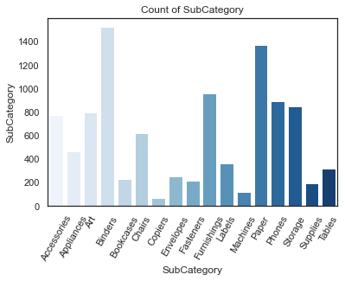
Analysis
By going through this thorough data cleaning process, we were able to uncover more information that would have been obscured by the inconsistencies and inaccuracies in the raw data. And with this newfound clarity, we were able to take the next step in our investigation and bring the superstore's financial struggles to a close.
Analysis Insights from EDA
Count of subcategory

Slide 9
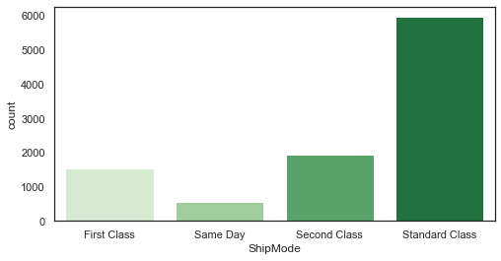
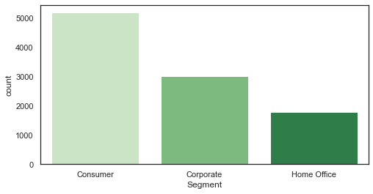
Most Preferred ship mode
Segment

Slide 10
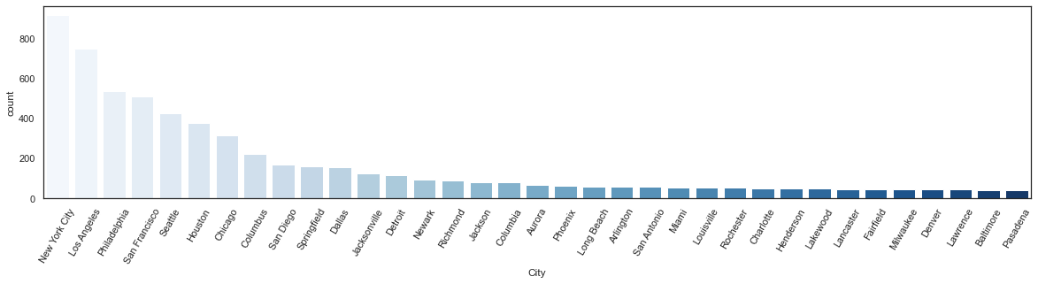
City

Slide 11
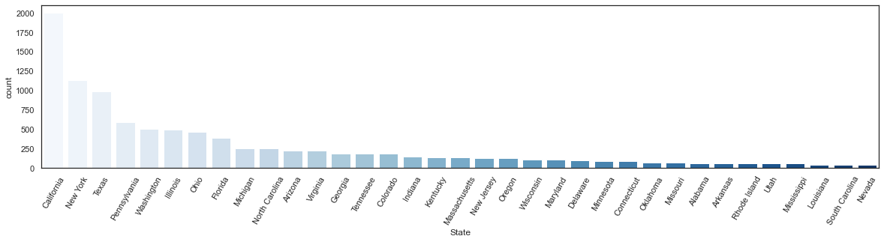
State

Slide 12
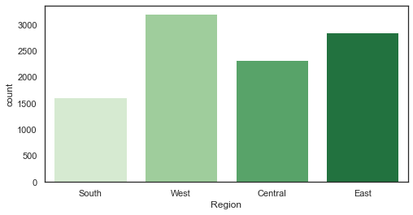
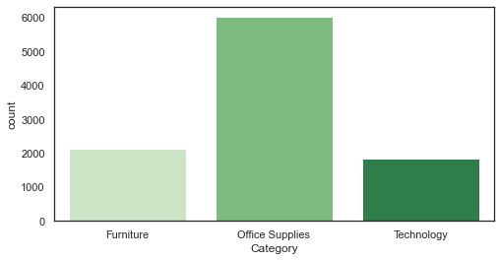
Region
Category

Slide 13
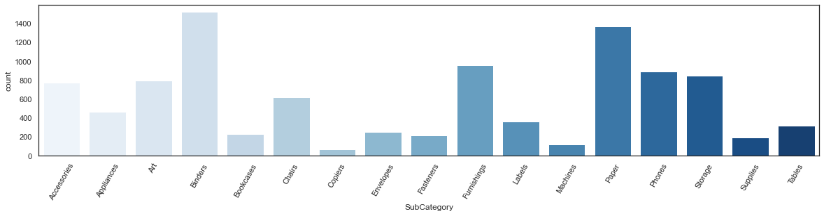
Subcategory

Slide 14
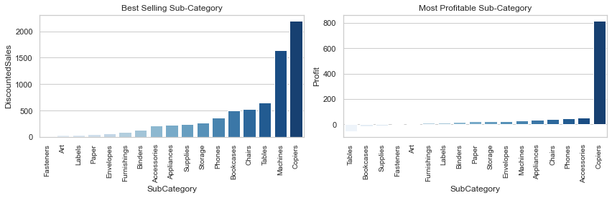
FINDINGS, RECOMMENDATIONS AND CONCLUSIONS
On analyzing the Super Store's sales and profitability data, it was found that the Technology sub-category and specific products such as Phones and Chairs are our highest selling and most profitable items. To offset losses from less profitable products such as Bookcases and Tables, I recommend bundling them with the high-performing items.

Slide 15
For customers looking for a home office setup, I suggest creating a package deal that includes a variety of office essentials such as a table, chairs, phone, copiers, storage, labels, fasteners, and bookcases. This is a great option for customers who are busy and may not have the time to select individual products.
To address the issue of losses from selling Supplies, Bookcases, and Tables, I recommend considering dropping these products from our catalog or renegotiating with suppliers for a cheaper price.
Our customer base is primarily made up of Consumer and Corporate segments, which make up over 70% of our customers. To target these segments, I suggest offering special promotions and bundles for mass Consumer and Home Offices in the top 10 cities with the highest sales, and sending promotional emails or flyers to customers in the East and West regions.

Slide 16
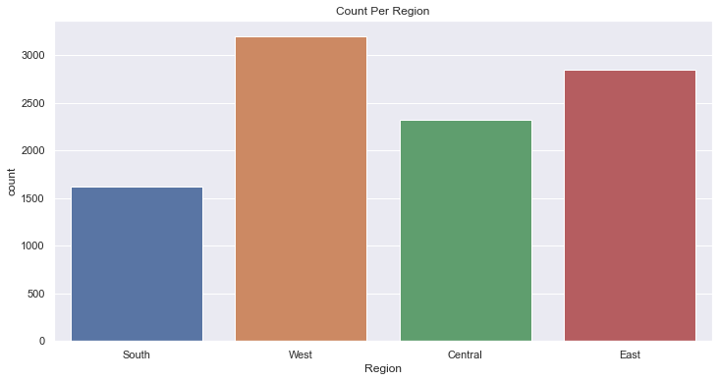
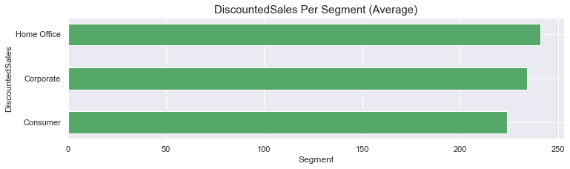

Slide 17
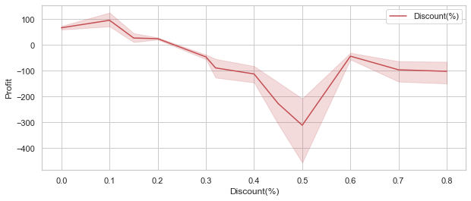
The main reason for losses is discounts. To improve this, I recommend offering more discounts during festival seasons, as this will result in more sales. During these seasons, the discount rate is recommended to be not more 20% as more than a 20% discount brings in great losses.
Additionally, the home office segment needs improvement. In some cities, we have fewer sales, which may be due to a lack of awareness. Advertising in these cities may help increase sales. For advertising strategy, in the event that the company wants to run product package promos, It is advised that the most common items that are usually bought together to inform the company's decision.

Slide 18
How did you customize the project and make it your own?
I have used Python 3 for this analysis. The Libraries/Packages I used in this projects are as follows:
NumPy (as np is one of the very famous packages for working with arrays in python)
pandas (Is greatly used in analysis of data and making data frame)
matplotlib (Lets make our Analyzation fun and interactive with the visualization library
matplotlib)
seaborn (Adding more colors into matplotlib visualization)

Slide 19
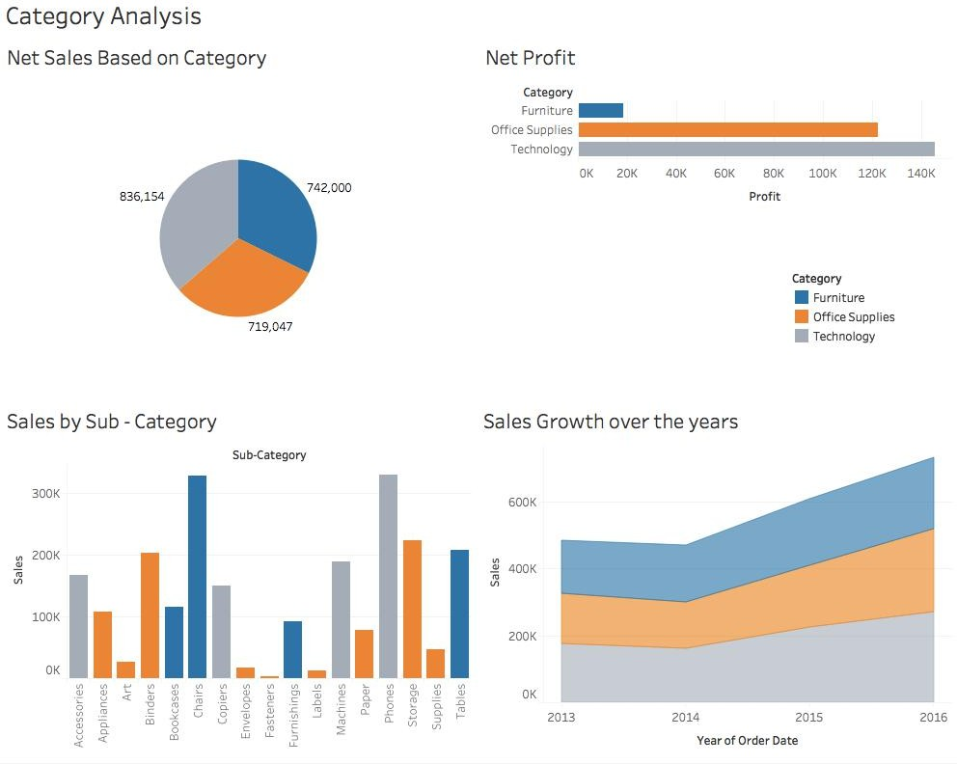
Modelling

Slide 20

Results
The analysis gives an overview of the sales of commodities. The observation contains a lot of information.
With that, we’ve come to the end of this analysis. The following are conclusions drawn from the analysis :-
Region with least sales is South in category furniture
Segment with least sales is Consumer
State with least sales is North Dakota
City with least sales is Abilene
Lowest shipping mode is on the Same Day

Slide 21
Useful Links
GitHub link :- https://github.com/satyam7718/Superstore-Analysis.git Dataset :- https://github.com/satyam7718/Superstore-Analysis/blob/main/Sample%20-%20Superstore.csv

Slide 22
THANK YOU
Satyam Raj

